Slide 1
Real-time Monitoring and Detection of Distracted Driving using Deep Neural Networks
Team Members
1. K Sudheevar Reddy - 1DS19CS065
2. Kiran N Deshmukh - 1DS19CS070
3. Lokesh M - 1DS19CS081
4. Prathik Raj RC- 1DS19CS117
Under the Guidance of
Dr. Kavitha K S
Professor Dept of Computer Science and Engineering
Department of Computer Science & Engineering, DSCE

Slide 2
PROBLEM STATEMENT
Distracted driving is any activity that diverts attention from driving, including talking or texting on your phone, eating and drinking, talking to people in your vehicle, fiddling with the stereo, entertainment or navigation system – anything that takes your attention away from the task of safe driving.
Therefore, it is essential to monitor and analyze the driver's behavior during the driving time to detect the distraction and mitigate the number of road accidents.

Slide 3
OBJECTIVES
The objectives of driver distraction detection are to:
1. Enhance driver safety: Address the critical issue of driver distraction, which poses a significant risk to road safety. The project aims to develop an intelligent system that can effectively detect and mitigate various forms of driver distraction, thereby reducing the likelihood of accidents and improving overall driver safety.
2. Integration with existing systems: Enable seamless integration with existing Advanced Driver Assistance Systems (ADAS) or in-car camera systems. By integrating the distraction detection system with these technologies, it can contribute to enhancing the capabilities of ADAS and provide an additional layer of safety and assistance to drivers.
3. Integration with insurance telematics: Integrate the distraction detection system with insurance telematics platforms to enable continuous monitoring of driver behavior. This integration can provide valuable data insights to insurance providers, allowing for personalized risk assessment and customized insurance offerings based on individual driver habits.
4. Support vehicle design and development: By providing data and insights on driver behavior, distraction detection systems can help manufacturers design and develop vehicles that are safer and more user-friendly.

Slide 4
ABSTRACT
Increasing prevalence of onboard systems and mobile phones has led to a rise in driver distractions, posing risks to road safety.
This research has aimed to address driver distractions by developing an efficient model for detection and mitigation.
Dataset restructuring and modification were performed to tailor the dataset to our specific requirements.
The YOLOv8 Object Detection model was utilized to accurately identify cell phone usage scenarios.
The VGG19 model was employed to detect other types of distractions, showcasing superior stability and accuracy.
Through data augmentation techniques and training on the augmented dataset, a validation accuracy of approximately 79.53% was achieved.
Our approach demonstrates the potential to enhance safety and driver assistance systems, contributing to improved road safety.

Slide 5
INTRODUCTION
Distracted driving poses significant risks and consequences, leading to an increase in road accidents and fatalities.
Distractions can be categorized into various types, including visual (e.g., looking at a mobile phone), manual (e.g., handling objects while driving), and cognitive (e.g., daydreaming or being mentally preoccupied).
The use of mobile phones and infotainment systems has become a prevalent source of distraction among drivers, diverting their attention away from the road.
Distracted driving impairs reaction time, decision-making, and situational awareness, increasing the likelihood of collisions and endangering the safety of drivers, passengers, and pedestrians.
Existing methods for detecting driver distractions are limited, often relying on subjective self-reporting or physical observation, which may not be accurate or practical in real-time scenarios.
Hence, there is a critical need for an objective and efficient methodology to detect driver distractions, enabling proactive measures to mitigate risks and enhance road safety.

Slide 6
LITERATURE SURVEY
Name | Authors | Models / Algorithms | Contributions | Limitations | Performance
1. Robust Deep Learning-Based Driver Distraction Detection and Classification | Amal Ezzouhri, Mounir Ghogho, Zakaria Charouh and Zouhair Guennoun | Cross-Domain Complementary Learning (CDCL), Human Body Part Segmentation (HBPS), Inception V3, VGG-19, | Most other deep learning approaches use the complete image to perform predictions. The drawback of this approach could be background noise that may lead to false positives. To overcome this, the model proposed in this work uses a segmentation module to detect human body parts and remove background noise to increase classification performance. | Occlusion and varying lighting conditions could lead to misclassification. The proposed approach is only successful in detecting visual and manual distractions, whereas cognitive distraction could also be a cause for road crashes. | The researchers have created their own dataset called the Driver Distraction Detection Dataset to use in conjunction with the Inception-v3 and VGG19 models respectively to achieve great accuracy scores of 93.42% and 95.77%. The segmentation module increases the accuracy by roughly 20% when compared to using raw RGB images.

Slide 7
Name | Authors | Models / Algorithms | Contributions | Limitations | Performance
2. Detecting Driver Behavior Using Stacked Long Short Term Memory Network With Attention Layer | Shokoufeh Monjezi Kouchak, Ashraf Gaffar | Multilayer Perceptron (MLP), Stacked LSTM with Attention Layer | The reason behind choosing the LSTM network is to remember the driver’s previous actions from the driving data to predict driver behaviour rather than simply using the driver’s instantaneous actions. LSTM is also advantageous in the sense that they keep both long-term and short-term memory and also have a feature of forgiveness to forget unimportant data that do not contribute to the intelligence of the system. | The scope of this work was limited to only predict one specific type of distraction, that is, the prolonged use of the infotainment system. The researchers affirm that future work can be done to identify other types of distractions as well. | The researchers found the minimum train and test error of the stacked LSTM to be 0.57 and 0.9, which were 0.4 less than the MLP minimum train and test error. Adding an attention layer to the LSTM model helped them achieve a train and test error of 0.69 and 0.75.

Slide 8
Name | Authors | Models / Algorithms | Contributions | Limitations | Performance
3. Detection of driver manual distraction via image-based hand and ear recognition | Li Li, Boxuan Zhong, Clayton Hutmacher Jr., Yulan Liang, William J. Horrey, Xu Xu | YOLO, Multilayer Perceptron (MLP) | The authors have proposed a novel method that has demonstrated comparable accuracy in both binary and multi-class classification while also achieving the top efficiency through leveraging the CNN and multi- layer perceptron. The multi-layer perceptron was easy to implement and demonstrated great performance in regression over low-dimensional data. The separation of the algorithm into two modules has made it easier to implement future modifications and updates. | More advanced network architectures could be explored to further in- crease the robustness of the algorithm, that could help divide each activity into sub-tasks with features that could provide significant contribution. | The results indicate that the proposed framework can detect normal driving scenarios, touchscreen usage, and engagement in phone calls with F1-scores of 0.84, 0.69, 0.82, respectively. It achieved an F1-score of 0.74 for overall detection of distraction.

Slide 9
Name | Authors | Models / Algorithms | Contributions | Limitations | Performance
4. Driver Drowsiness Prediction Based on Multiple Aspects Using Image Processing Techniques | V. Uma Maheshwari, Rajanikanth Aluvalu, MVV Prasad Kantipudi, Krishnakeerthi Chennam, Ketan Kotecha and Jatinderkumar R. Saini | Convolutional Neural Network | The proposed framework makes use of various data points that include the novel FAR (Facial Aspect Ratio) to combat occlusion issues and provide an overall robust mechanism. The researchers have also designed their own dataset called EMOCDS that works well with the neural network proposed. | This method proves disadvantageous in the sense that the gestures of people can vary dynamically. The authors also suggest that the model can be enhanced by extracting more features and using ensemble classification algorithms. | The proposed approach with this model and the proposed dataset (EMOCDS) produced an aggregate accuracy of 95.67%.
5. Driver Distraction Behavior Detection Method Based on Deep Learning | Peng Mao, Kunlun Zhang and Da Liang | PSN, DSST, YOLOV3 | The method proposed is fairly simple to implement and outputs considerable accuracy rates. | Although the method has a high object recognition rate, it is easy to mis-classify other objects similar to the shape of smoke as smoke when they appear near the mouth. | This simple approach outputs a recall score of 85.4% and the precision scores for cigarettes and mobile phones are 95.7% and 97.3% respectively with a speed of 36fps.

Slide 10
Name | Authors | Models / Algorithms | Contributions | Limitations | Performance
6. A Data Augmentation Approach to Distracted Driving Detection | Jing Wang, ZhongCheng Wu, Fang Li and Jun Zhang | Faster R-CNN, Xception, AlexNet, Inception-v3 | The method proposed has been found to improve the accuracy of classification and has strong generalisation capabilities while also showing that it can extract vital information. It provides a robust mechanism that can be used as a preprocessing step in analysing driver behaviour. | The dataset used here only sparsely includes driving scenarios under low lighting or night conditions and the model needs verification on larger datasets. Further improvements could be made to detect a combination of distractions that could occur together by using object detection models like YOLO. | The results show that the classification accuracy was as high as 96.97% with the Xception model as a result of using the data augmentation approach.
7. Online Prediction of Driver Distraction Based on Brain Activity Patterns | Shouyi Wang, Yiqi Zhang, Changxu Wu, Member, IEEE, Felix Darvas, and Wanpracha Art Chaovalitwongse | Electroencephalographic (EEG) signals, | The proposed model provides a practical tool to solve the challenging problem of online predicting driver distraction using EEG signals. | The model is too complicated to include in the existing hardware systems. | The proposed model had an overall accuracy for prediction of the start and end of map viewing were 81% and 70% respectively.

Slide 11
Name | Authors | Models / Algorithms | Contributions | Limitations | Performance
8. Driver Cell Phone Usage Detection From HOV/HOT NIR Images | Yusuf Artan, Orhan Bulan, Robert P. Loce, and Peter Paul | Deformable Part Model (DPM), SVM Classifier | The model proposed is robust in the sense that it is not vulnerable to occlusion since it uses half images with a blend of non-occluded images too. | The training dataset used contains a very limited collection of images. This could lead to misclassification when exposed to different setups. | The proposed model is found to achieve an accuracy score of 86% in detecting mobile phone usage, which hence, plays a vital role in predicting distraction.
9. A Hybrid Deep Learning Approach for Driver Distraction Detection | Jimiama Mafeni Mase, Peter Chapman, Grazziela P. Figueredo, Mercedes Torres Torres | InceptionV3 network, LSTM | Due to its ability to understand the spatial and spectral properties of the images, the researchers were able to attain an accuracy rate of 92.7%, outperforming the state-of-the-art CNN model. | The dataset used by the researchers only has a limited set of parameters. If the driver's actions fall outside of these parameters the accuracy will fall. | Due to its ability to understand the spatial and spectral properties of the images, the researchers were able to attain an accuracy rate of 92.7%.

Slide 12
Name | Authors | Models / Algorithms | Contributions | Limitations | Performance
10. Distracted Driver Detection Based on a CNN With Decreasing Filter Size | Binbin Qin, Jiangbo Qian, Yu Xin, Yihong Dong and Baisong Liu | D-HCNN | The D-HCNN model only uses 0.76M parameters, that is considerably a smaller number when compared to other models. The decreasing filter size technique helps achieve high speeds in terms of processing and fine-tunes the process. | Although the decreasing filter size achieves great results in terms of speed and accuracy, it starts to weaken with increase in the depth of the neural network. | Experimental evaluations on two datasets, AUC Distracted Driver (AUCD2) and State Farm Distracted Driver Detection (SFD3) led to accuracy scores of 95.59% and 99.87% respectively.
11. Leveraging Smartphone Sensors to Detect Distracted Driving Activities | Kaoutar Ben Ahmed, Bharti Goel, Pratool Bharti, Sriram Chellappan and Mohammed Bouhorma | Data from Accelerometer and Gyroscope on smartphones, Random Forest Classifier | It uses a very simple and light, non-compute intensive approach that uses sensory data of very commonly available sensors on smartphones while achieving considerably high accuracy scores. | Real roads have not been simulated in this work, which means that potholes, undulations, U-turns, speed breakers, sharp turns, excess winds etc. haven’t been included as part of the research. This could lead to false alarms due to spikes in the gyroscope and accelerometer readings. | The experimentation results are summarised as follows – 85% Precision, 84% Recall and 87% for F-Measure when data from both sensors were combined.

Slide 13
Name | Authors | Models / Algorithms | Contributions | Limitations | Performance
12. HCF: A Hybrid CNN Framework for Behavior Detection of Distracted Drivers | Chen Huang, Xiaochen Wang, Jiannong Cao, Shihui Wang and Yan Zhang | ResNet50, Inception V3, Xception trained using Momentum Based Training Rate Optimization (MTRO) | Concatenating feature vectors from three different pretrained models helps with achieving higher accuracy when compared to using a single model. | The dataset used in this work only contains images captured from the right-hand side. Hence, the performance of the proposed model may weaken when the camera is placed in different places in the vehicle. The model also performs poorly at nighttime. | The results of the experiment show that the proposed HCF framework is able to achieve a significant boost in accuracy when compared to using a single pretrained network. The model has been proven to achieve an accuracy score of 96.74% when detecting distracted driver behaviour.
13. A Driver Face Monitoring System for Fatigue and Distraction Detection | Mohamad-Hoseyn Sigari, Mahmood Fathy and Mohsen Soryani | Haar-like features and adaptive boosting method, template matching method | Fuzzy logic method is used to efficiently estimate driver fatigue and distraction. | Since the proposed system is a face tracking method , it is inaccurate and complex to compute. | The proposed model achieved and accuracy of 90.8% for detection head rotation of the driver.

Slide 14
Name | Authors | Models / Algorithms | Contributions | Limitations | Performance
14. Drive-Net: Convolutional Network for Driver Distraction Detection | Mohammed S. Majdiy, Sundaresh Ram, Jonathan T. Gilly, Jeffrey J. Rodr´ıguezy | Convolutional Neural Network (CNN), Random Decision Forest | The proposed model achieved a better detection accuracy compared to Recurrent Neural Network (RNN) and a Multi-Layer Perceptron (MLP) algorithm. | Training a CNN model with a large dataset can lead to over-fitting the model. | The proposed model(Drive-Net) was compared with Recurrent Neural Network (RNN), and a Multi-Layer Perceptron (MLP) by testing them with publicly available dataset of images used in Kaggle competition and Drive-net achieved better accuracy (97%) compared to RNN and MLP’s accuracy (95%).
15. Driver Distraction Detection with A Camera Vision System | Matti Kutila, Maria Jokela, Gustav Markkula, Maria Romera Rué | Support vector machine (SVM) | The results for cognitive distraction detection are encouraging, notably in the passenger car case (86%) and in truck application result (68%). | The accuracy obtained is less in the truck application because in a metropolis, cognitive distraction is far more difficult to detect. | The results for cognitive distraction detection are encouraging, notably in the passenger car case (86%). However, the truck application result (68%) is not as strong.

Slide 15
Name | Authors | Models / Algorithms | Contributions | Limitations | Performance
16. optNet-50: An Optimized Residual Neural Network Architecture of Deep Learning for Driver’s Distraction | Tahir Abbas, Aadil Ziya Khan, Irfan Kareem, Syed Farooq Ali | OptNet-50: Optimised ResNet-50 | OptNet-50 exhibited a time efficiency comparable to ResNet-50, ResNet-101 and MobileNet. optNet-50 is 3.44 times faster than ResNet-101 and 2.44 times faster than MobileNet. | The model is able to classify hand and facial movements but it could be improvised to further include other factors such as swerving between lanes and driver emotions. | After experimentation, it was proven that the proposed model achieved higher accuracy (98%) and runs 3.44 times faster than the existing ResNet-101(91%) model at lower running costs.
17. Multiple Scale Faster-RCNN Approach to Driver’s Cell-phone Usage and Hands on Steering Wheel Detection | T. Hoang Ngan Le, Yutong Zheng, Chenchen Zhu, Khoa Luu and Marios Savvides | Multiple Scale Faster-RCNN (MS- FRCNN), Region Proposal Network (RPN) generation | The proposed model has been proven to achieve greater performance than the standard R-CNN model. | The approach followed in this paper relies on counting the number of hands on the steering wheel. But, each driver has a unique style of driving eg. he/she can have his hands on the gear lever, at times. The proposal also fails to classify in under/over illumination scenarios, with occlusion being a common scenario across multiple proposals. | This model is proven to have achieved greater accuracy than the standard R-CNN model tested on two datasets, VIVA and SHRP-2.

Slide 16
DEVELOPMENT STEPS
Data Collection - Collect a large and diverse dataset of driver behavior, including both distracted and non-distracted driving examples.
Dataset Preparation - Reorganise the dataset into train-test-validation sets to induce generalization and improve robustness of the model.
Data Augmentation - Augment the data to increase the size and diversity of the dataset. This may involve applying random transformations to the data, such as rotations and flips, to create additional examples.
Model Selection - Choose a suitable deep learning model architecture for the task, such as a CNN.
Model Training - Train the model on the preprocessed and augmented data using suitable optimization algorithms. Transfer learning is one of the best approaches that can be used.
Model Validation - Validate the model's performance using a separate validation dataset. Make adjustments and fine tune the classifier to achieve desired accuracy.
Model Deployment - Integrate the trained model into a system for detecting driver distraction in real-time.

Slide 17
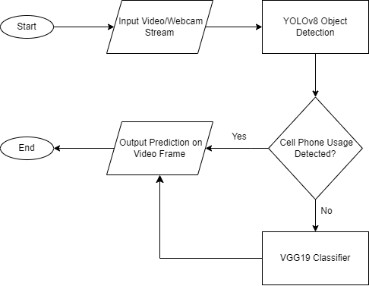
SYSTEM DESIGN

Slide 18
IMPLEMENTATION
1. DATASET SPLIT
While exploring the Statefarm Dataset, we initially followed the common practice of randomly splitting the dataset into training, testing, and validation sets using ratios like 70-15-15. However, during this process, we observed a data leakage.
To overcome this issue and ensure a more accurate assessment of our model's capabilities, we adopted a different approach to dataset splitting. Instead of random splits, we divided the dataset based on driver IDs.
We exclusively included images of 18 unique drivers in the training set, while allocating four different drivers each to the testing and validation sets. By implementing this driver-based split, we effectively minimized the occurrence of data leakage and obtained a more reliable evaluation of our model's generalization performance.

Slide 19
As part of our preprocessing steps, we introduced additional modifications to enhance the relevance and applicability of our dataset.
One important adjustment involved horizontally flipping all the images in the dataset. This step was taken to align the dataset with the driving conditions prevalent in India, where driving occurs on the left side of the road. By flipping the images, we ensured that our model was trained to detect distractions in a manner consistent with Indian driving practices.
Furthermore, we made a decision to remove four specific classes from the dataset that pertained to the use of mobile phones for texting and talking, both with the left and right hand. We deemed these classes redundant, as our objective was to focus on the detection of other distractions.
By eliminating these classes, we streamlined our dataset and narrowed the scope of our model's training to the remaining six classes, which encompassed a range of different distractions commonly observed while driving.

Slide 20
2. TRAINING
The key steps involved in the training phase are as follows:
1. Dataset Augmentation
Augmentation techniques: We incorporated various data augmentation techniques such as rotation, width and height shifts, and shear range shifts to introduce variability and enhance the robustness of our model.
2. Model Architecture
VGG19 as the base model: We selected the VGG19 architecture due to its deep convolutional structure, which has demonstrated effectiveness in computer vision tasks.
Modification of fully connected layers: The fully connected layers of the VGG19 model were adapted to our specific task. We added a dense layer with 512 neurons and ReLU activation, a dropout layer with a dropout rate of 0.3, and a final dense layer with 6 neurons representing the number of classes.

Slide 21
3. Compilation and Training:
Model compilation: The modified VGG19 model was compiled with appropriate loss function (e.g., categorical cross-entropy) and optimizer (e.g., Adam optimizer).
Training on augmented dataset: The model was trained using the augmented dataset, consisting of the flipped and augmented images, to improve its ability to detect and classify driver distractions. The training process involved multiple epochs to optimize the model's performance.
4. Performance Evaluation:
Validation accuracy assessment: The model's validation accuracy was continuously monitored during training to evaluate its performance on unseen data and assess its ability to generalize.
Comparison with other models: We conducted comparisons with other existing models in the field of driver distraction detection to benchmark and validate the effectiveness of our trained VGG19 model.
The use of pretrained YOLOv8 model for identifying cell phone usage significantly reduced misclassifications and mad the system robust.

Slide 22
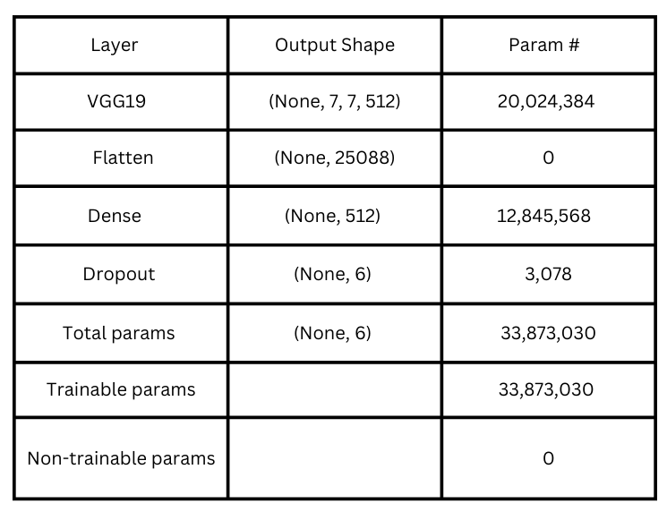
Model Architecture

Slide 23
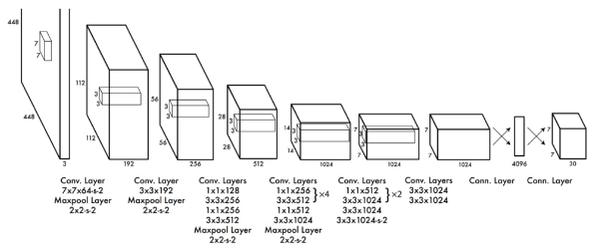
YOLOv8 Architecture

Slide 24
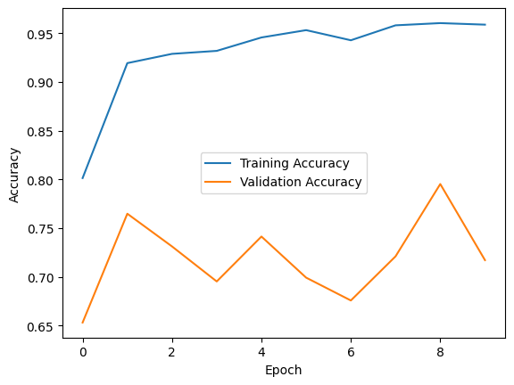
RESULTS
Plot of Training vs Validation Accuracy

Slide 25
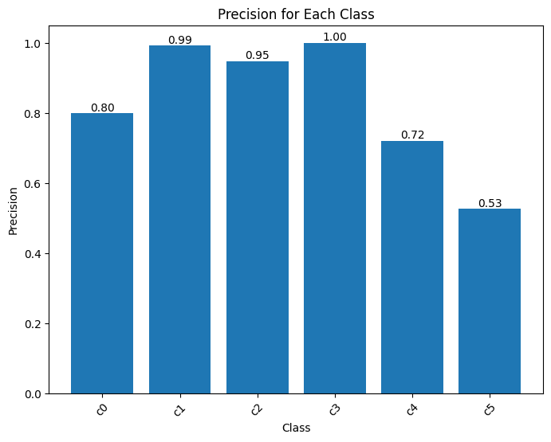
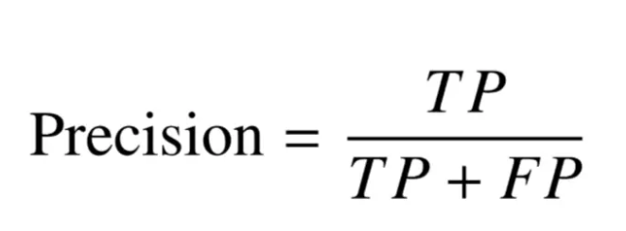
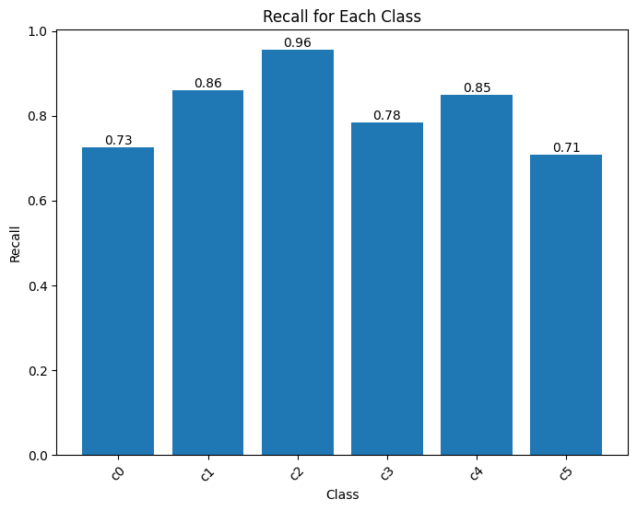
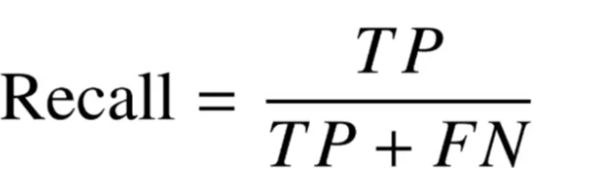

Slide 26
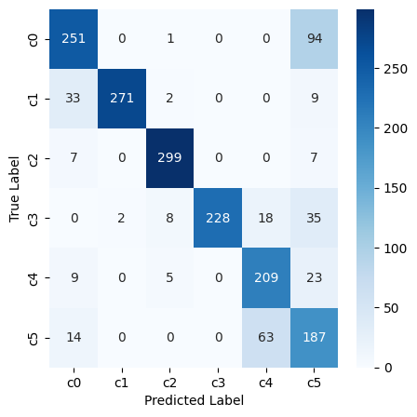
Confusion Matrix

Slide 27
EXPERIMENT
Our experiment is summarised as follows:
Developed and implemented a real-time experiment using a web camera module.
Successfully streamed video input and performed predictions on each frame in real-time.
Performance Challenges and CPU Limitations:
Encountered performance limitations due to reliance on the central processing unit (CPU) for computational tasks.
Experienced significant performance overhead with CPU-based computations.
Maximum frame rates achieved were approximately 2.5 to 3 frames per second (fps) for input videos and 1 to 1.5 fps for live webcam input.
Need for GPU Acceleration:
Recognized the need for GPU acceleration to overcome performance limitations.
Highlighted the potential of a dedicated graphics processing unit (GPU) to enhance system performance significantly.
GPU utilization allows for higher frame rates and real-time analysis with reduced computational overhead.

Slide 28
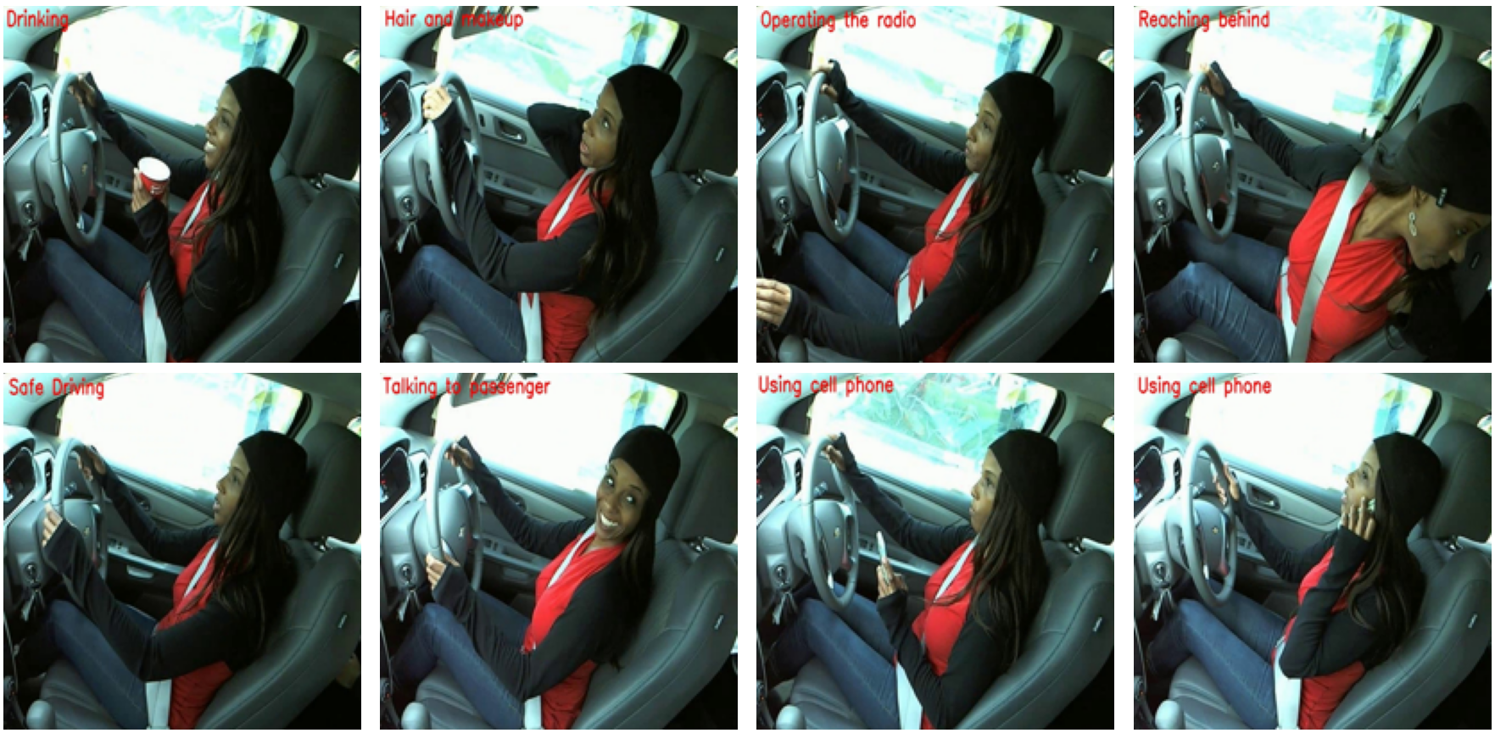
Streamlit User Interface Development:
Developed a user-friendly Streamlit application as a graphical user interface (GUI).
Empowered users to upload pre-recorded videos or utilize the webcam input for real-time analysis.

Slide 29
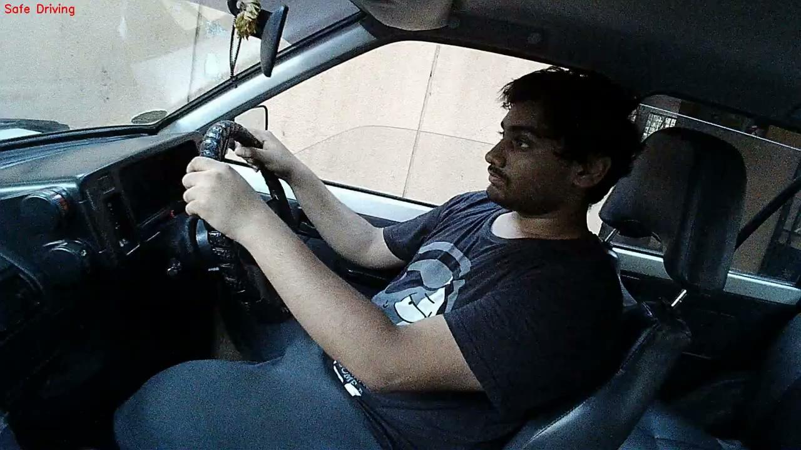
MODEL PERFORMANCE

Slide 30
CONCLUSION
In conclusion, our research has demonstrated promising results in terms of accuracy and performance for driver distraction detection. By carefully customizing the dataset and utilizing advanced models, we achieved a validation accuracy of approximately 79%, showcasing the effectiveness of our approach.
However, it is important to note that the performance of our system was limited by the computational overhead of using only the CPU, resulting in frame rates of around 2.5 to 3 frames per second on input videos and 1 to 1.5 frames per second on webcam input.
By leveraging a powerful GPU, we can improve the performance and achieve higher frame rates, enabling real-time analysis and enhancing the practicality of our system for deployment in real-world scenarios.

Slide 31
FUTURE WORK
Expanding the dataset to include a wider range of distractions and diverse driving scenarios would enhance the model's generalization capabilities.
Integration of other sensors like in-car cameras and physiological sensors can provide a more comprehensive understanding of driver behavior.
Addressing limitations related to low-lighting or nighttime conditions by incorporating diverse lighting scenarios into the dataset.
Integrating the driver distraction detection system with Advanced Driver Assistance Systems (ADAS) to develop a comprehensive and robust system for driver assistance and safety.

Slide 32


PROJECT TOOL SNAPSHOT

Slide 33
CONTRIBUTIONS
BATCH NO: 8
K Sudheevar Reddy 1DS19CS065 Model Research Object Detection Model Comparisons | Kiran N Deshmukh 1DS19CS070 Model Training Dataset Preparation Implementation Paper Experiment
Lokesh M 1DS19CS081 Dataset Preparation Annotating Images Frontend GUI | Prathik Raj RC 1DS19CS117 Frontend GUI Experiment Flowcharts and Designs

Slide 34
THANK YOU

